Slide 1
Natural Language Processing

Slide 2
Tokenization
Tokenization is a simple process that takes raw data and converts it into a useful data string. While tokenization is well known for its use in cybersecurity and in the creation of NFTs, tokenization is also an important part of the NLP process.
Tokenization is used in natural language processing to split paragraphs and sentences into smaller units that can be more easily assigned meaning.

Slide 3
Kinds of Tokenization
Word Tokenization
Sentence Tokenization
Character Tokenization

Slide 4
Import nltk
From nltk.tokenize import word_tokenize,sent_tokenize

Slide 5
Regular Expression(re)
re.match()
re.search()
re.findall()

Slide 6
Special Sequences in Regular Expressions
\b
\b returns a match where the specified pattern is at the beginning or at the end of a word.
str = r'Analytics Vidhya is the largest Analytics community of India' #Check if there is any word that ends with "est" x = re.findall(r"est\b", str) print(x)

Slide 7
\d returns a match where the string contains digits (numbers from 0-9).
str = "2 million monthly visits in Jan'19." #Check if the string contains any digits (numbers from 0-9): x = re.findall("\d", str) print(x)
adding '+' after '\d' will continue to extract digits till encounters a space

Slide 8
\D returns a match where the string does not contain any digit. It is basically the opposite of \d.
str = "2 million monthly visits in Jan'19." #Check if the word character does not contain any digits (numbers from 0-9): x = re.findall("\D", str) print(x)

Slide 9
\w helps in extraction of alphanumeric characters only (characters from a to Z, digits from 0-9, and the underscore _ character)
str = "2 million monthly visits!" #returns a match at every word character (characters from a to Z, digits from 0-9, and the underscore _ character) x = re.findall("\w+",str) print(x)
https://www.analyticsvidhya.com/blog/2021/03/beginners-guide-to-regular-expressions-in-natural-language-processing/

Slide 10
Stop words
Stop words are a set of commonly used words in a language. Examples of stop words in English are “a,” “the,” “is,” “are,” etc. Stop words are commonly used in Text Mining and Natural Language Processing (NLP) to eliminate words that are so widely used that they carry very little useful information.

Slide 11
Bag of Words
Bag of words is a Natural Language Processing technique of text modelling. In technical terms, we can say that it is a method of feature extraction with text data. This approach is a simple and flexible way of extracting features from documents.
A bag of words is a representation of text that describes the occurrence of words within a document. We just keep track of word counts and disregard the grammatical details and the word order. It is called a “bag” of words because any information about the order or structure of words in the document is discarded. The model is only concerned with whether known words occur in the document, not where in the document.

Slide 12
Example
Sentence 1: ”Welcome to Great Learning, Now start learning”
Sentence 2: “Learning is a good practice”

Slide 13
Step 1: Go through all the words in the above text and make a list of all of the words in our model vocabulary.
Welcome
To
Great
Learning
,
Now
start
learning
is
a
good
practice

Slide 14
Sentence | Welcome | to | Great | Learning | , | Now | start | learning | is | a | good | practice
Sentence1 | 1 | 1 | 1 | 1 | 1 | 1 | 1 | 1 | 0 | 0 | 0 | 0
Sentence2 | 0 | 0 | 0 | 0 | 0 | 0 | 0 | 1 | 1 | 1 | 1 | 1
https://www.mygreatlearning.com/blog/bag-of-words/

Slide 15
What are N-Grams?
N-grams are continuous sequences of words or symbols, or tokens in a document. In technical terms, they can be defined as the neighboring sequences of items in a document. They come into play when we deal with text data in NLP (Natural Language Processing) tasks. They have a wide range of applications, like language models, semantic features, spelling correction, machine translation, text mining, etc.

Slide 16
Unigram and Bi gram
To generate 1-grams we pass the value of n=1 in ngrams function of NLTK. But first, we split the sentence into tokens and then pass these tokens to ngrams function.
from nltk.util import ngrams n = 1 sentence = 'You will face many defeats in life, but never let yourself be defeated.' unigrams = ngrams(sentence.split(), n)
for grams in unigrams: print grams

Slide 17
Stemming & Lemmatization
Stemming is a technique used to reduce an inflected word down to its word stem. For example, the words “programming,” “programmer,” and “programs” can all be reduced down to the common word stem “program.” In other words, “program” can be used as a synonym for the prior three inflection words.
Lemmatization is another technique used to reduce inflected words to their root word. It describes the algorithmic process of identifying an inflected word’s “lemma” (dictionary form) based on its intended meaning.

Slide 18
Advantages of Stemming
Improved model performance: Stemming reduces the number of unique words that need to be processed by an algorithm, which can improve its performance. Additionally, it can also make the algorithm run faster and more efficiently.
Grouping similar words: Words with a similar meaning can be grouped together, even if they have distinct forms. This can be a useful technique in tasks such as document classification, where it’s important to identify key topics or themes within a document.
Easier to analyze and understand: Since stemming typically reduces the size of the vocabulary, it’s much easier to analyze, compare, and understand texts. This is helpful in tasks such as sentiment analysis, where the goal is to determine the sentiment of a document.

Slide 19
Disadvantages of Stemming
Overstemming / False positives: This is when a stemming algorithm reduces separate inflected words to the same word stem even though they are not related; for example, the Porter Stemmer algorithm stems "universal", "university", and "universe" to the same word stem. Though they are etymologically related, their meanings in the modern day are from widely different domains. Treating them as synonyms will reduce relevance in search results.
Understemming / False negatives: This is when a stemming algorithm reduces inflected words to different word stems, but they should be the same. For example, the Porter Stemmer algorithm does not reduce the words “alumnus,” “alumnae,” and “alumni” to the same word stem, although they should be treated as synonyms.
Language challenges: As the target language's morphology, spelling, and character encoding get more complicated, stemmers become more difficult to design; For example, an Italian stemmer is more complicated than an English stemmer because there is a higher number of verb inflections. A Russian stemmer is even more complex due to more noun declensions.

Slide 20
Advantages and Disadvantages of Lemmatization
Adavantages:
Accuracy: Lemmatization does not merely cut words off as you see in stemming algorithms. Analysis of words is conducted based on the word’s POS to take context into consideration when producing lemmas. Also, lemmatization leads to real dictionary words being produced.
Disadvantages :
Time-consuming: Compared to stemming, lemmatization is a slow and time-consuming process. This is because lemmatization involves performing morphological analysis and deriving the meaning of words from a dictionary.

Slide 21
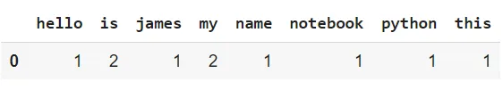
Count Vectorizer
text = [‘Hello my name is james, this is my python notebook’]
text = [‘hello my name is james’,‘Hello my name is James’] coun_vect = CountVectorizer(lowercase=False)
count_matrix = coun_vect.fit_transform(text) count_array = count_matrix.toarray() df = pd.DataFrame(data=count_array,columns = coun_vect.get_feature_names())

Slide 22
STeps to perform
Convert to lowercase
Split the document
Remove stopwrods
Apply stemming and Lematization
Convert to string

Slide 23
Bag Of Words Model Vs. Countvectorizer
The difference between the Bag Of Words Model and CountVectorizer is that the Bag of Words Model is the goal, and CountVectorizer is the tool to help us get there.

Slide 24
TFIDF
TF-IDF defines importance of a term by taking into consideration the importance of that term in a single document, and scaling it by its importance across all documents.
t=term
d=document
D=set of documents

Slide 25
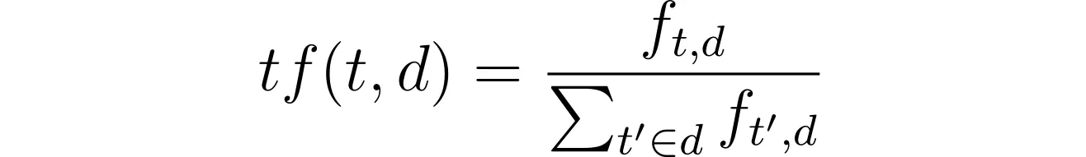
Term Frequency
Term frequency answers the question of, how many times does this word appear in this document among the number of times all words appear in this document? In other words, how important is this word to this specific document?

Slide 26
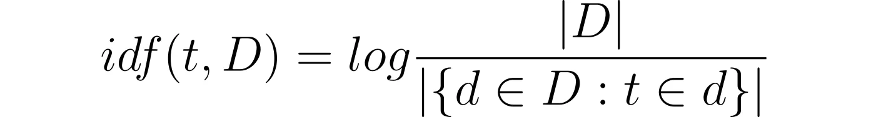
IDF
Inverse document frequency answers the question of, how common (or uncommon) is this word among all the documents I have?
https://towardsdatascience.com/how-tf-idf-works-3dbf35e568f0

Slide 27
Why TFIDF is better than CountVectorizer
One reason TFIDF usually performs better than CountVectorizer in machine learning models is that CountVectorizer treats all words equally without penalty.

Slide 28
Advantages and disadvantages
Advantages: - Easy to compute - You have some basic metric to extract the most descriptive terms in a document - You can easily compute the similarity between 2 documents using it
Disadvantages: - TF-IDF is based on the bag-of-words (BoW) model, therefore it does not capture position in text, semantics, co-occurrences in different documents, etc. - For this reason, TF-IDF is only useful as a lexical level feature - Cannot capture semantics (e.g. as compared to topic models, word embeddings)

Slide 29
Word2Vec
Word2Vec creates vectors of the words that are distributed numerical representations of word features – these word features could comprise of words that represent the context of the individual words present in our vocabulary. Word embeddings eventually help in establishing the association of a word with another similar meaning word through the created vectors.
Word2vec is a two-layer neural net that processes text by “vectorizing” words. Its input is a text corpus and its output is a set of vectors: feature vectors that represent words in that corpus. While Word2vec is not a deep neural network, it turns text into a numerical form that deep neural networks can understand.

Slide 30
Word2vec can make highly accurate guesses about a word’s meaning based on past appearances. Those guesses can be used to establish a word’s association with other words (e.g. “man” is to “boy” what “woman” is to “girl”), or cluster documents and classify them by topic. Those clusters can form the basis of search, sentiment analysis and recommendations in such diverse fields as scientific research, legal discovery, e-commerce and customer relationship management.

Slide 31
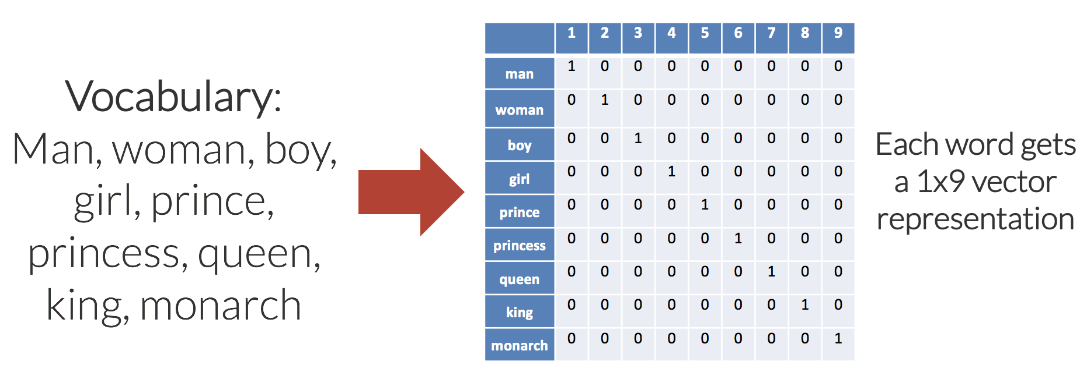

Slide 32
Why we need it?
Let us consider the two sentences – “You can scale your business.” and “You can grow your business.”. These two sentences have the same meaning. If we consider a vocabulary considering these two sentences, it will constitute of these words: {You, can, scale, grow, your, business}.
A one-hot encoding of these words would create a vector of length 6. The encodings for each of the words would look like this:
You: [1,0,0,0,0,0], Can: [0,1,0,0,0,0], Scale: [0,0,1,0,0,0], Grow: [0,0,0,1,0,0],
Your: [0,0,0,0,1,0], Business: [0,0,0,0,0,1]
In a 6-dimensional space, each word would occupy one of the dimensions, meaning that none of these words has any similarity with each other – irrespective of their literal meanings.
Word2Vec, a word embedding methodology, solves this issue and enables similar words to have similar dimensions and, consequently, helps bring context.

Slide 33
https://www.analyticsvidhya.com/blog/2021/07/word2vec-for-word-embeddings-a-beginners-guide/

Slide 34
CBOW
The CBOW architecture comprises a deep learning classification model in which we take in context words as input, X, and try to predict our target word, Y.
For example, if we consider the sentence – “Word2Vec has a deep learning model working in the backend.”, there can be pairs of context words and target (center) words. If we consider a context window size of 2, we will have pairs like ([deep, model], learning), ([model, in], working), ([a, learning), deep) etc. The deep learning model would try to predict these target words based on the context words.

Slide 35
Skip-gram
In the skip-gram model, given a target (centre) word, the context words are predicted. So, considering the sentence “Word2Vec has a deep learning model working in the backend.” and a context window size of 2, given the center word ‘learning’, the model tries to predict [‘deep’, ’model’] and so on.
Since the skip-gram model has to predict multiple words from a single given word, we feed the model pairs of (X, Y) where X is our input and Y is our label. This is done by creating positive input samples and negative input samples.
Positive Input Samples will have the training data in this form: [(target, context),1] where the target is the target or centre word, context represents the surrounding context words, and label 1 indicates if it is a relevant pair. Negative Input Samples will have the training data in the same form: [(target, random),0]. In this case, instead of the actual surrounding words, randomly selected words are fed in along with the target words with a label of 0 indicating that it’s an irrelevant pair.

Slide 36
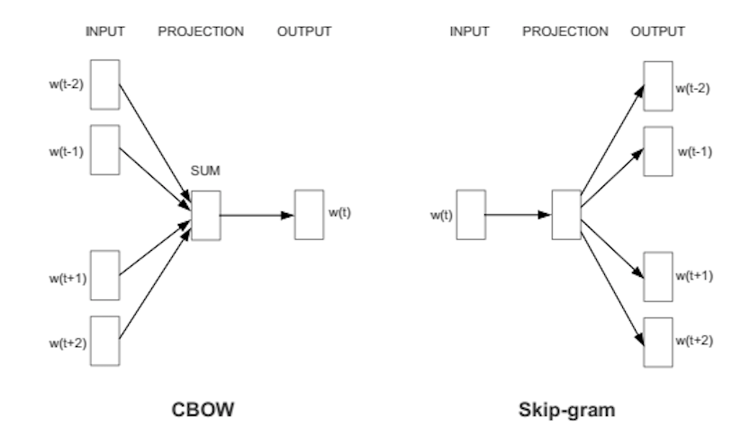

Slide 37
import gensim from gensim.models import Word2Vec
Model =gensim.models.Word2Vec(data, min_count = 1,size = 100, window = 5, sg=0)
Model.wv.vocab

Slide 38
TFIDF vs Word2Vec
TF-IDF is a word-document mapping (with some normalization). It ignores the order of words and gives nxm matrix (or mxn depending on implementation) where n is number of words in the vocabulary and m is number of documents. Word2Vec on the other hand gives a unique vector for each word based on the words appearing around the particular word.
TF-IDF is obtained from straightforward linear algebra. Word2Vec is obtained from the hidden layer of a two layered neural network.
TF-IDF can be used either for assigning vectors to words or to documents. Word2Vec can be directly used to assign vector to a word but to get the vector representation of a document further processing is needed.
Unlike TF-IDF Word2Vec takes into account placement of words in a document(to some extent).

Slide 39
RNN
Recurrent Neural Network(RNN) is a type of Neural Network where the output from the previous step are fed as input to the current step. In traditional neural networks, all the inputs and outputs are independent of each other, but in cases like when it is required to predict the next word of a sentence, the previous words are required and hence there is a need to remember the previous words. Thus RNN came into existence, which solved this issue with the help of a Hidden Layer. The main and most important feature of RNN is Hidden state, which remembers some information about a sequence.

Slide 40
RNN have a “memory” which remembers all information about what has been calculated. It uses the same parameters for each input as it performs the same task on all the inputs or hidden layers to produce the output. This reduces the complexity of parameters, unlike other neural networks.

Slide 41
Types of RNN
1.One-to-One
2.One-to-Many
3.Many-to-One
4.Many-to-Many

Slide 42
One-to-One
The simplest type of RNN is One-to-One, which allows a single input and a single output. It has fixed input and output sizes and acts as a traditional neural network. The One-to-One application can be found in Image Classification.

Slide 43
One-to-Many
One-to-Many is a type of RNN that gives multiple outputs when given a single input. It takes a fixed input size and gives a sequence of data outputs. Its applications can be found in Music Generation and Image Captioning.

Slide 44
Many-to-One
Many-to-One is used when a single output is required from multiple input units or a ﻿sequence of them. It takes a sequence of inputs to display a fixed output. Sentiment Analysis is a common example of this type of Recurrent Neural Network.

Slide 45
Many-to-Many
Many-to-Many is used to generate a sequence of output data from a sequence of input units.
This type of RNN is further divided into ﻿the following two subcategories:
1. Equal Unit Size: In this case, the number of both the input and output units is the same. A common application can be found in Name-Entity Recognition.
2. Unequal Unit Size: In this case, inputs and outputs have different numbers of units. Its application can be found in Machine Translation.

Slide 46


Slide 47
Training through RNN
A single-time step of the input is provided to the network.
Then calculate its current state using a set of current input and the previous state.
The current ht becomes ht-1 for the next time step.
One can go as many time steps according to the problem and join the information from all the previous states.
Once all the time steps are completed the final current state is used to calculate the output.
The output is then compared to the actual output i.e the target output and the error is generated.
The error is then back-propagated to the network to update the weights and hence the network (RNN) is trained.

Slide 48
Advantages of Recurrent Neural Network
An RNN remembers each and every piece of information through time. It is useful in time series prediction only because of the feature to remember previous inputs as well. This is called Long Short Term Memory.
Recurrent neural networks are even used with convolutional layers to extend the effective pixel neighborhood.
Disadvantages of Recurrent Neural Network
Gradient vanishing and exploding problems.
Training an RNN is a very difficult task.
It cannot process very long sequences if using tanh or relu as an activation function.
Short term memory problem.

Slide 49
Applications of Recurrent Neural Network
Language Modelling and Generating Text
Speech Recognition
Machine Translation
Image Recognition, Face detection
Time series Forecasting

Slide 50
LSTM
LSTM stands for Long-Short Term Memory. LSTM is a type of recurrent neural network but is better than traditional recurrent neural networks in terms of memory. Having a good hold over memorizing certain patterns LSTMs perform fairly better. As with every other NN, LSTM can have multiple hidden layers and as it passes through every layer, the relevant information is kept and all the irrelevant information gets discarded in every single cell.

Slide 51
Why LSTM?
Tradition neural networks suffer from short-term memory. Also, a big drawback is the vanishing gradient problem. ( While backpropagation the gradient becomes so small that it tends to 0 and such a neuron is of no use in further processing.) LSTMs efficiently improves performance by memorizing the relevant information that is important and finds the pattern.

Slide 52

How it works
LSTM has 3 main gates.
1. FORGET Gate 2. INPUT Gate 3. OUTPUT Gate

Slide 53
FORGET Gate
This gate is responsible for deciding which information is kept for calculating the cell state and which is not relevant and can be discarded. The h_{t-1} is the information from the previous hidden state (previous cell) and x_{t} is the information from the current cell. These are the 2 inputs given to the Forget gate. They are passed through a sigmoid function and the ones tending towards 0 are discarded, and others are passed further to calculate the cell state.

Slide 54
2. INPUT Gate
Input Gate updates the cell state and decides which information is important and which is not. As forget gate helps to discard the information, the input gate helps to find out important information and store certain data in the memory that relevant. h_{t-1} and x_{t} are the inputs that are both passed through sigmoid and tanh functions respectively. tanh function regulates the network and reduces bias.

Slide 55
3. Cell State
All the information gained is then used to calculate the new cell state. The cell state is first multiplied with the output of the forget gate. This has a possibility of dropping values in the cell state if it gets multiplied by values near 0. Then a pointwise addition with the output from the input gate updates the cell state to new values that the neural network finds relevant.

Slide 56
4. OUTPUT Gate
The last gate which is the Output gate decides what the next hidden state should be. h_{t-1} and x_{t} are passed to a sigmoid function. Then the newly modified cell state is passed through the tanh function and is multiplied with the sigmoid output to decide what information the hidden state should carry.

Slide 57
Step 1: Decide How Much Past Data It Should Remember
The first step in the LSTM is to decide which information should be omitted from the cell in that particular time step. The sigmoid function determines this. It looks at the previous state (ht-1) along with the current input xt and computes the function.
Consider the following two sentences:
Let the output of h(t-1) be “Alice is good in Physics. John, on the other hand, is good at Chemistry.”
Let the current input at x(t) be “John plays football well. He told me yesterday over the phone that he had served as the captain of his college football team.”
The forget gate realizes there might be a change in context after encountering the first full stop. It compares with the current input sentence at x(t). The next sentence talks about John, so the information on Alice is deleted. The position of the subject is vacated and assigned to John.

Slide 58
Step 2: Decide How Much This Unit Adds to the Current State
In the second layer, there are two parts. One is the sigmoid function, and the other is the tanh function. In the sigmoid function, it decides which values to let through (0 or 1). tanh function gives weightage to the values which are passed, deciding their level of importance (-1 to 1).
With the current input at x(t), the input gate analyzes the important information — John plays football, and the fact that he was the captain of his college team is important.
“He told me yesterday over the phone” is less important; hence it's forgotten. This process of adding some new information can be done via the input gate.

Slide 59
Step 3: Decide What Part of the Current Cell State Makes It to the Output
The third step is to decide what the output will be. First, we run a sigmoid layer, which decides what parts of the cell state make it to the output. Then, we put the cell state through tanh to push the values to be between -1 and 1 and multiply it by the output of the sigmoid gate.
Let’s consider this example to predict the next word in the sentence: “John played tremendously well against the opponent and won for his team. For his contributions, brave ____ was awarded player of the match.”
There could be many choices for the empty space. The current input brave is an adjective, and adjectives describe a noun. So, “John” could be the best output after brave.

